Slide 1


Steelhead Smolt Routing through the South Delta
Rebecca Buchanan
Columbia Basin Research
School of Aquatic and Fishery Sciences
University of Washington
Seattle, WA
Bay-Delta Office Friday Lunch Seminar
Bureau of Reclamation
June 20, 2025

Slide 2
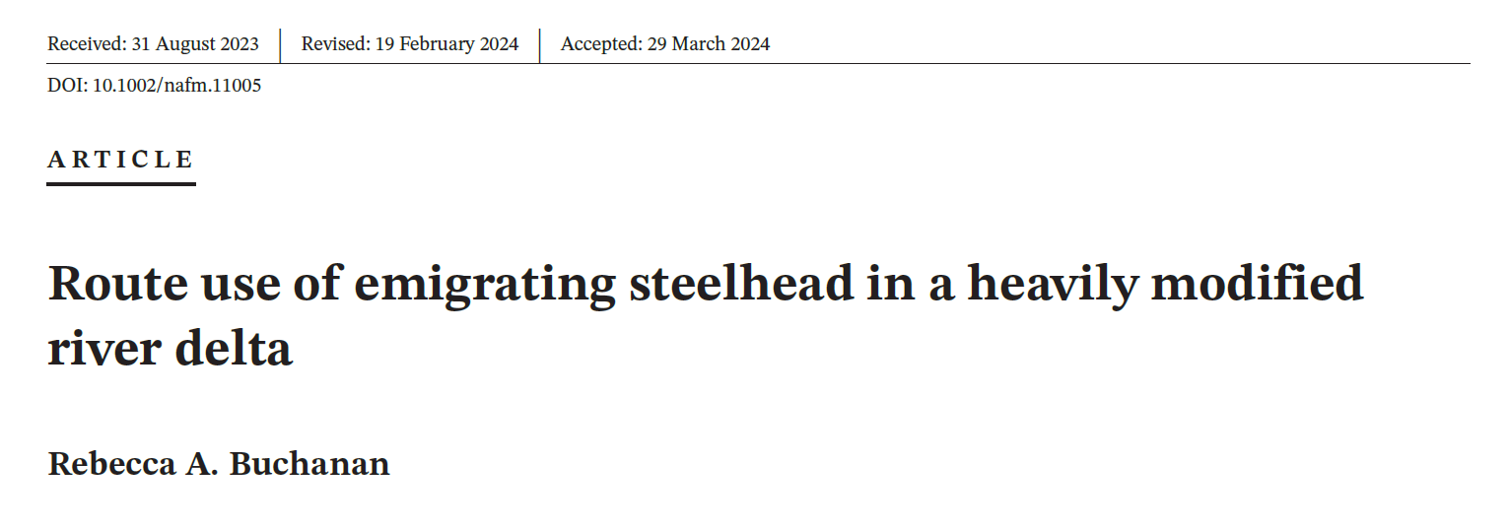
Outline
Steelhead routing questions in the South Delta
2011 – 2016 six-year steelhead study
Results: Estimated route usage in the South Delta
Modeling overview and hypotheses
Results: Route use predictions, review of hypotheses
Buchanan 2024 (NAJFM)

Slide 3
San Joaquin River steelhead smolts – multiple routing options through South Delta
SJO
Notes:
Regardless of the route choice at the head of Old River, fish may still be salvaged and trucked.
When I talk about the SJR route, it means essentially that the fish stayed in the mainstem SJR at whatever junction is being discussed, whether it is the head of Old River or Turner Cut – it does not refer to fish route use at junctions further downstream.

Slide 4
San Joaquin River steelhead smolts
Route-specific survival to Chipps Island
Higher in the mainstem San Joaquin River
Lower in the interior Delta
Largest difference is from Turner Cut to Chipps Island
Research questions
How much are the different routes used?
What factors drive route use at channel junctions in the South Delta?
How well do management metrics predict routing compared to local flow conditions?
SJO
Notes:
We know from previous work by Anchor QEA that local flow patterns influence short-term movements of steelhead in the South Delta. We also know that individual fish may encounter a river junction multiple times, so is it still those local flow conditions that dictate the final route choice?
Also, while it may make mechanical sense that local flow conditions dictate route use, that isn’t particularly useful for making predictions for management because we generally don’t have realtime data on those local conditions and we cannot control local conditions directly. Instead, what we have available are “management metrics” such as Delta inflow and exports which generally represent conditions at some remote location (Vernalis or the water export facilities) – how well do those metrics predict routing compared to local flow conditions?

Slide 5
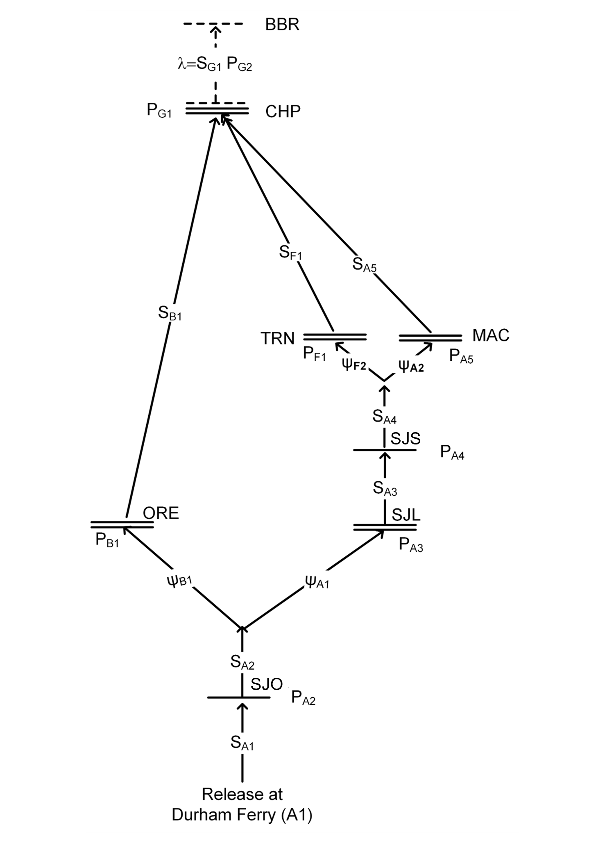
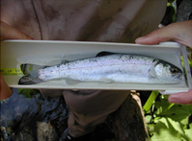
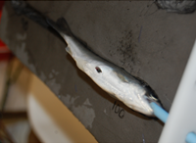
Steelhead acoustic telemetry data
First 6-year study
2011 – 2016
Fish source: Mokelumne River Fish Hatchery
958 – 2,196 juveniles tagged and released at Durham Ferry each year
Fork length at tagging: 106 – 396 mm, average = 245 mm, SD = 29.6 mm
Objective 1: Estimate release-level migration & survival probabilities
Reach-specific survival
Route use probability
Route-specific survival
Through-Delta survival
Objective 2: Model survival as function of operational, environmental, and individual covariates (Buchanan et al. 2021)
Objective 3: Model route use as function of operational, environmental, and individual covariates (Buchanan 2024)
Notes:
The bulk of the fish ranged from 185 – 315 mm
Survival from HOR to Chipps Island: Delta inflow, temperature, IE, X2, barrier – mostly Delta inflow
Survival from HOR to TCJ: Delta inflow, Brandt Bridge flow, IE, Temperature, CVP exports – mostly Delta inflow
Survival from TCJ to Chipps Island: only migration route and maybe fork length are associated with survival

Slide 6
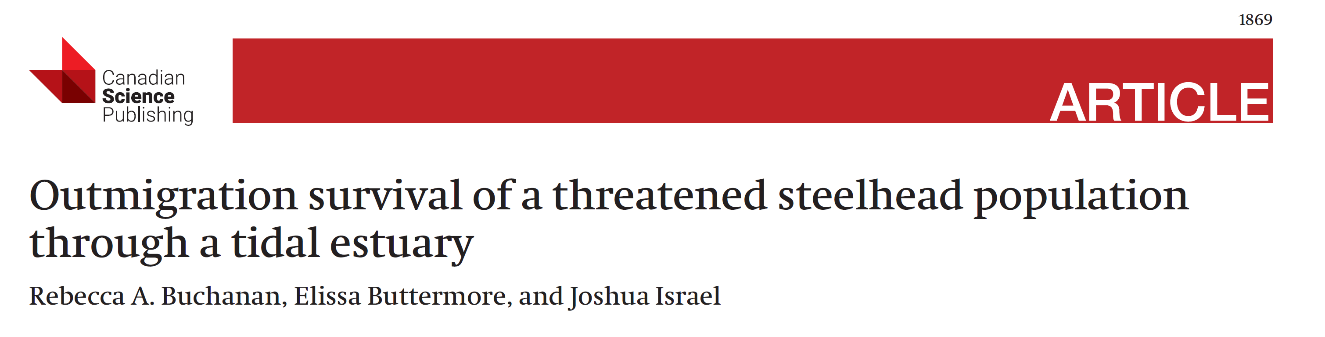
Delta Inflow Conditions
Buchanan et al. 2021, Figure 3

Slide 7
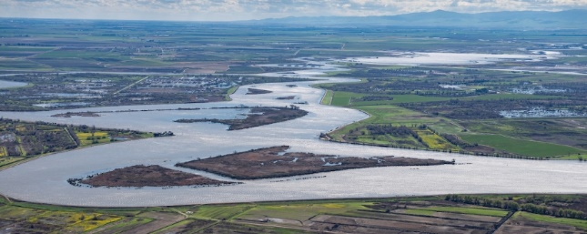
Estimation Results
Middle River Mouth; photo credit = Ken James, CDWR

Slide 8
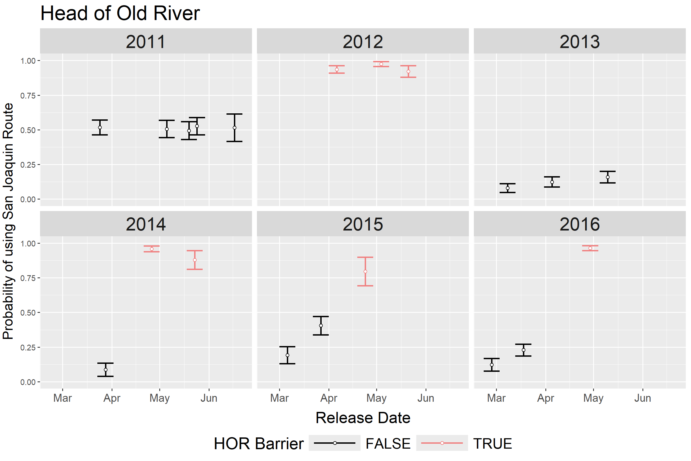
Route Use Estimates – Head of Old River
Use of San Joaquin River route is higher when barrier is in place
Within-year variation is low in years without barrier (2011 and 2013)

Slide 9
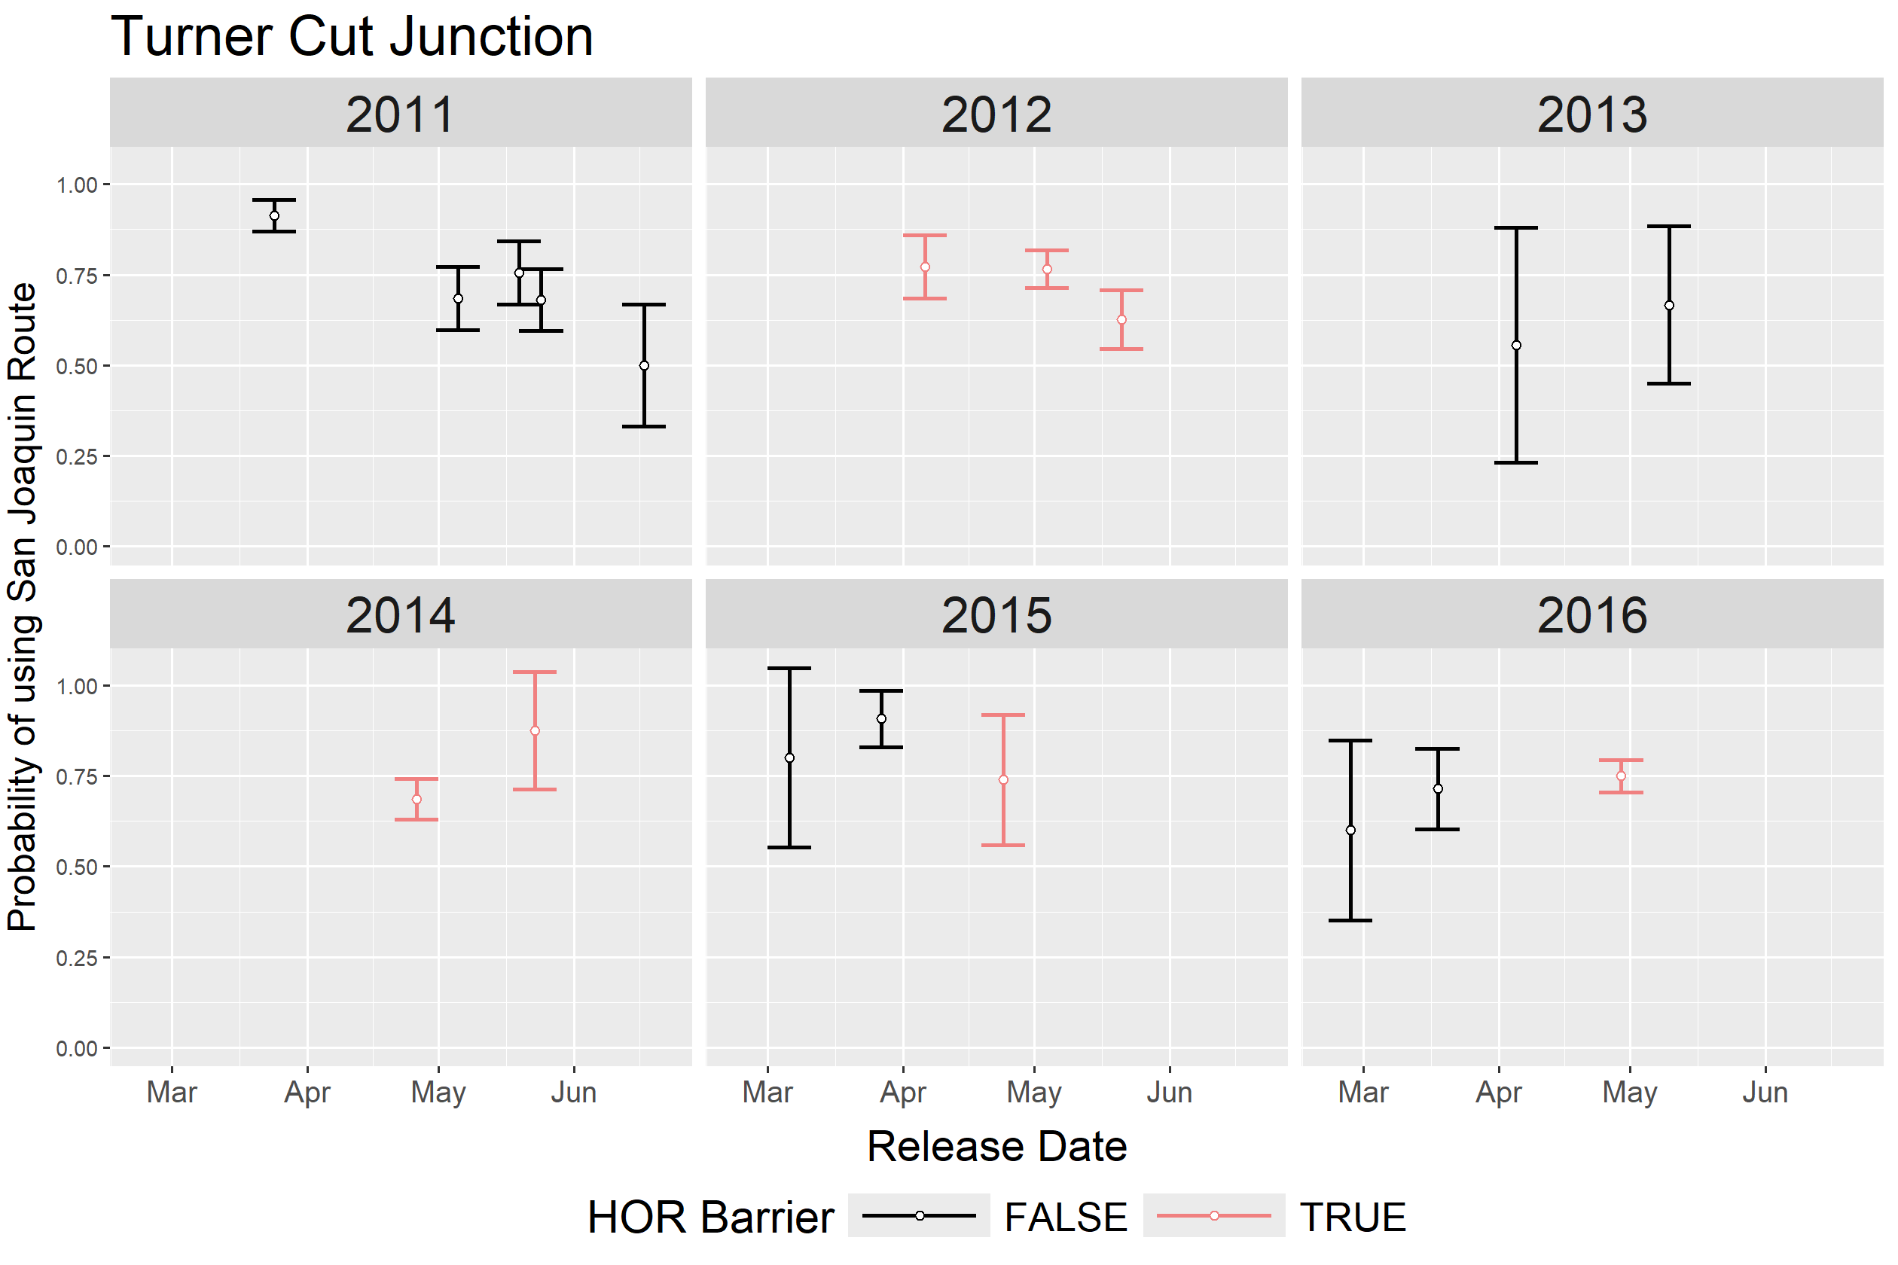
Route Use Estimates – Turner Cut
HOR barrier has no obvious effect on use of San Joaquin River route
There is more variation within some years (2011)
Estimates are less precise

Slide 10
Modeling Overview
Middle River Mouth; photo credit = Ken James, CDWR

Slide 11
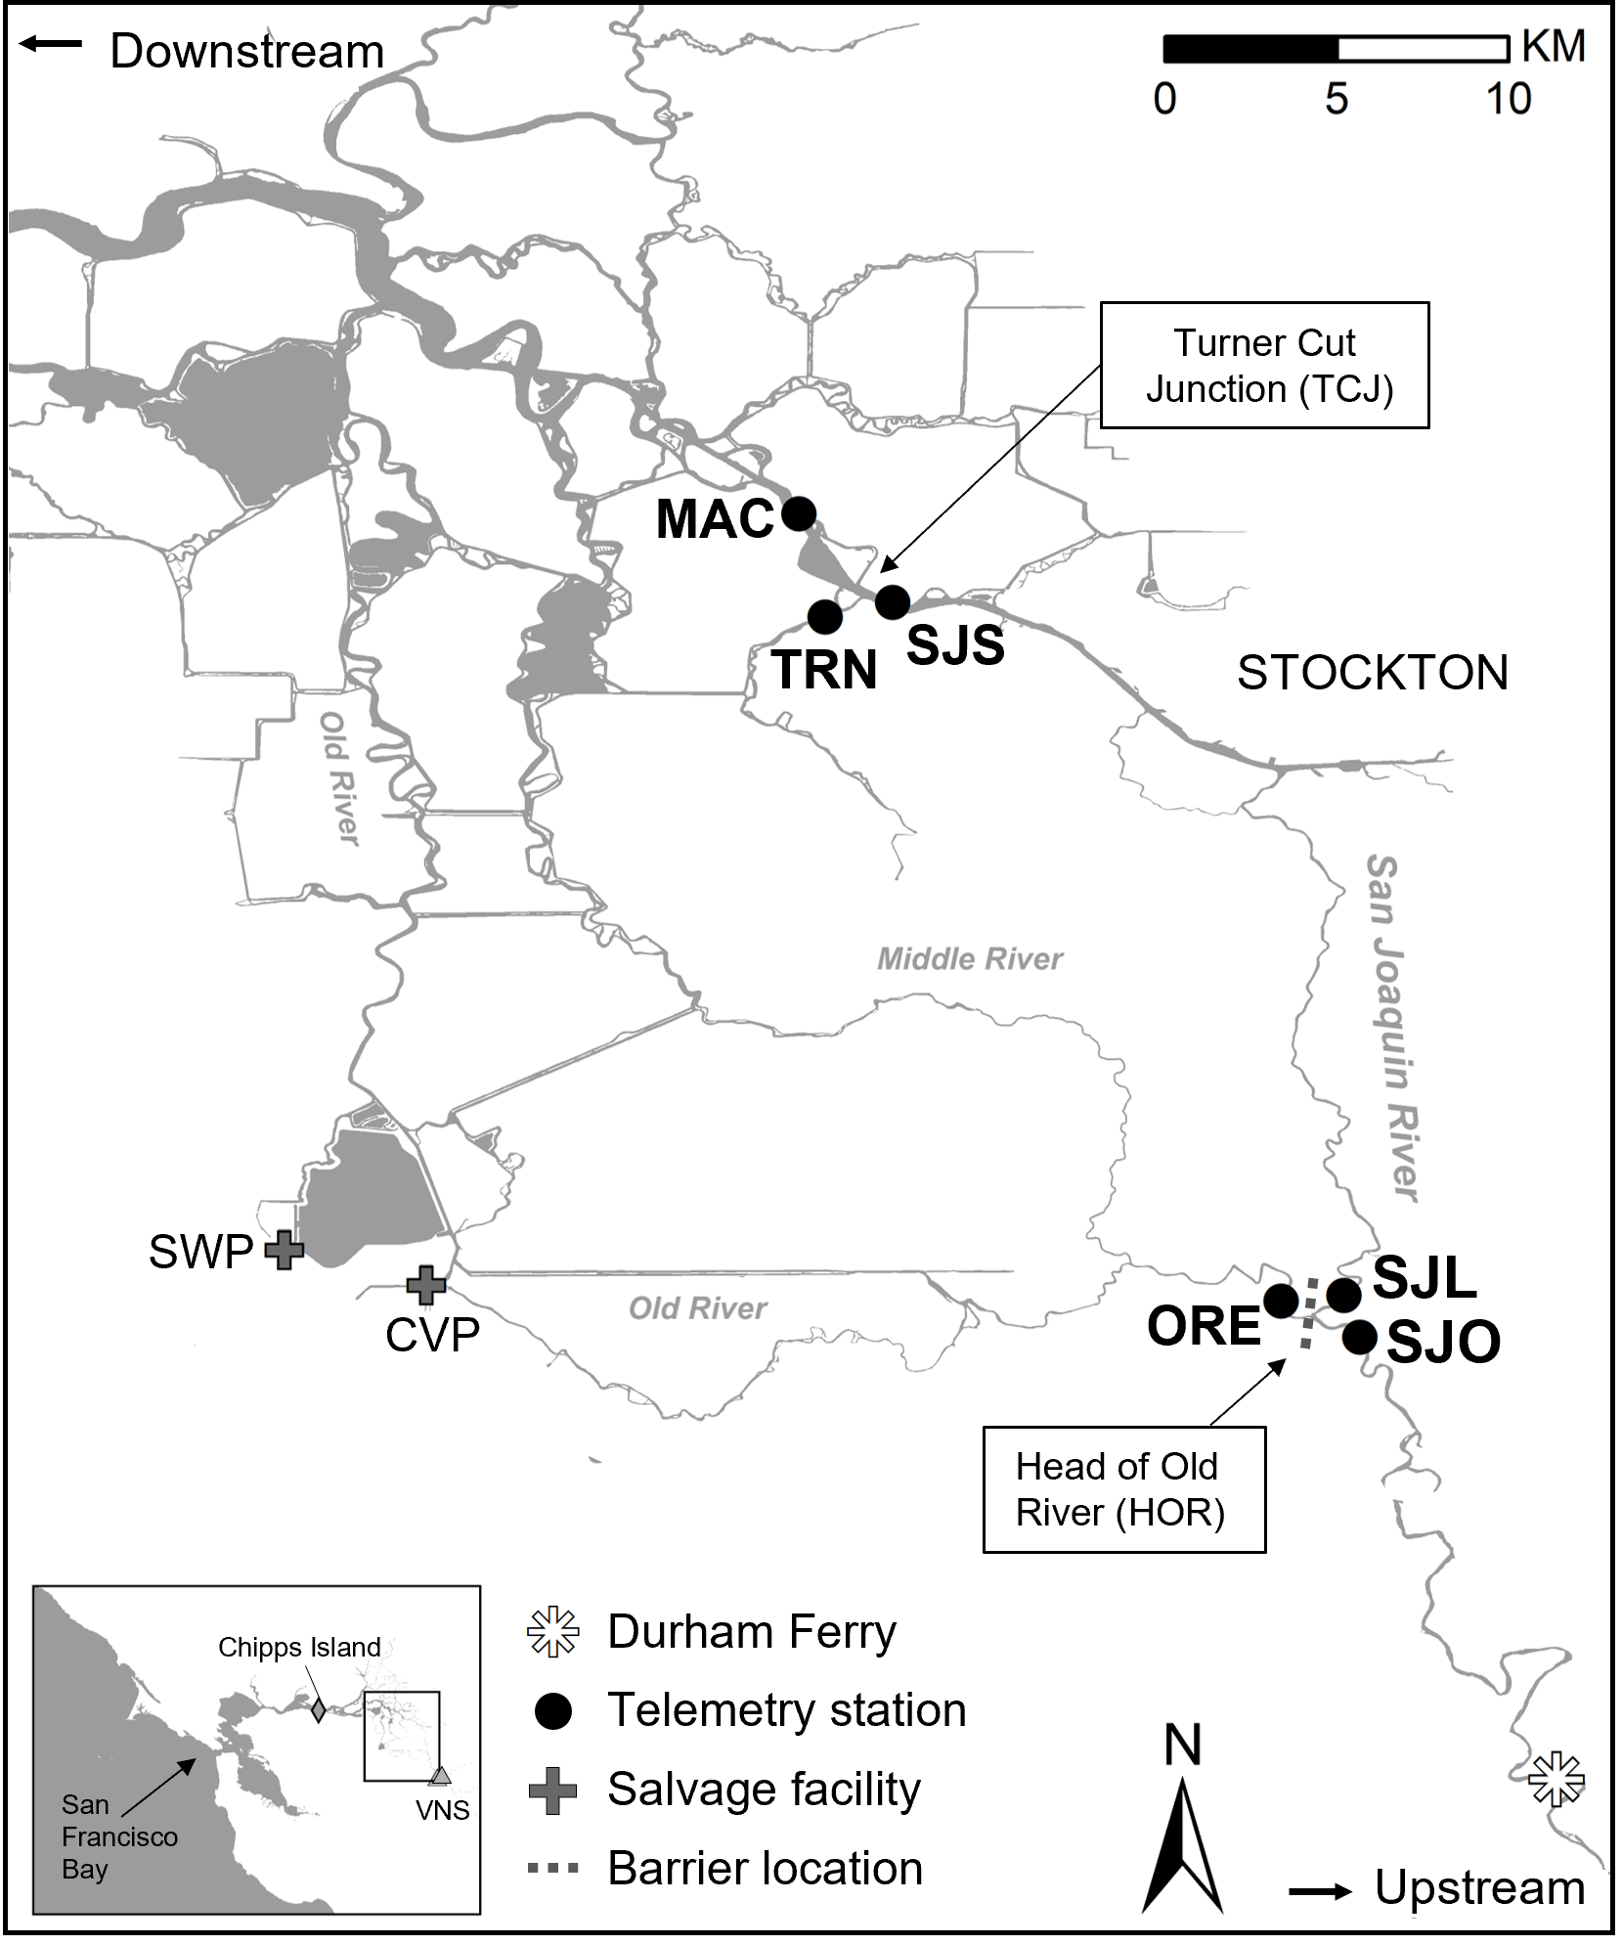
Develop routing model
Junctions
Head of Old River
Turner Cut
Model
Individual-based GLM (Bernoulli errors, logit link)
Model averaging (MuMIn package in R)
Assess predictive ability via AUC
Covariates
Local conditions: Tidal flow, Net flow, Flow proportion
Management metrics: Exports, Delta inflow, IE
Individual metrics: Fork length, Time of Day, HOR barrier
“Local”, “Management”, and “Combined” models
Notes:
“Multi-Model Inference” package
AUC = Area Under the receiver operating characteristic Curve
Local and management covariates defined basis for two competing models
Also developed “combined” model

Slide 12
Hypothesis 1: Fish follow flow
Steelhead smolts’ routing is determined mostly by localized flow conditions
Smolts are more likely to select mainstem route when:
Flow proportion is higher in mainstem
Net flow entering junction from upstream is higher
On ebb tide
What I expected to find

Slide 13
Hypothesis 2: Management metrics predict routing
Metrics used in water operations management can be used to predict routing at HOR and TCJ
Fish are more likely to enter the interior Delta when
Daily export rates are higher
Delta inflow is lower
I:E ratio is lower
What I expected to find

Slide 14
Hypothesis 3: Individual conditions matter
Fish size
Larger fish are more likely to remain in mainstem because they are better able to maneuver
Time of day
Visual cues
Predator evasion actions
No effect direction predicted
What I expected to find

Slide 15
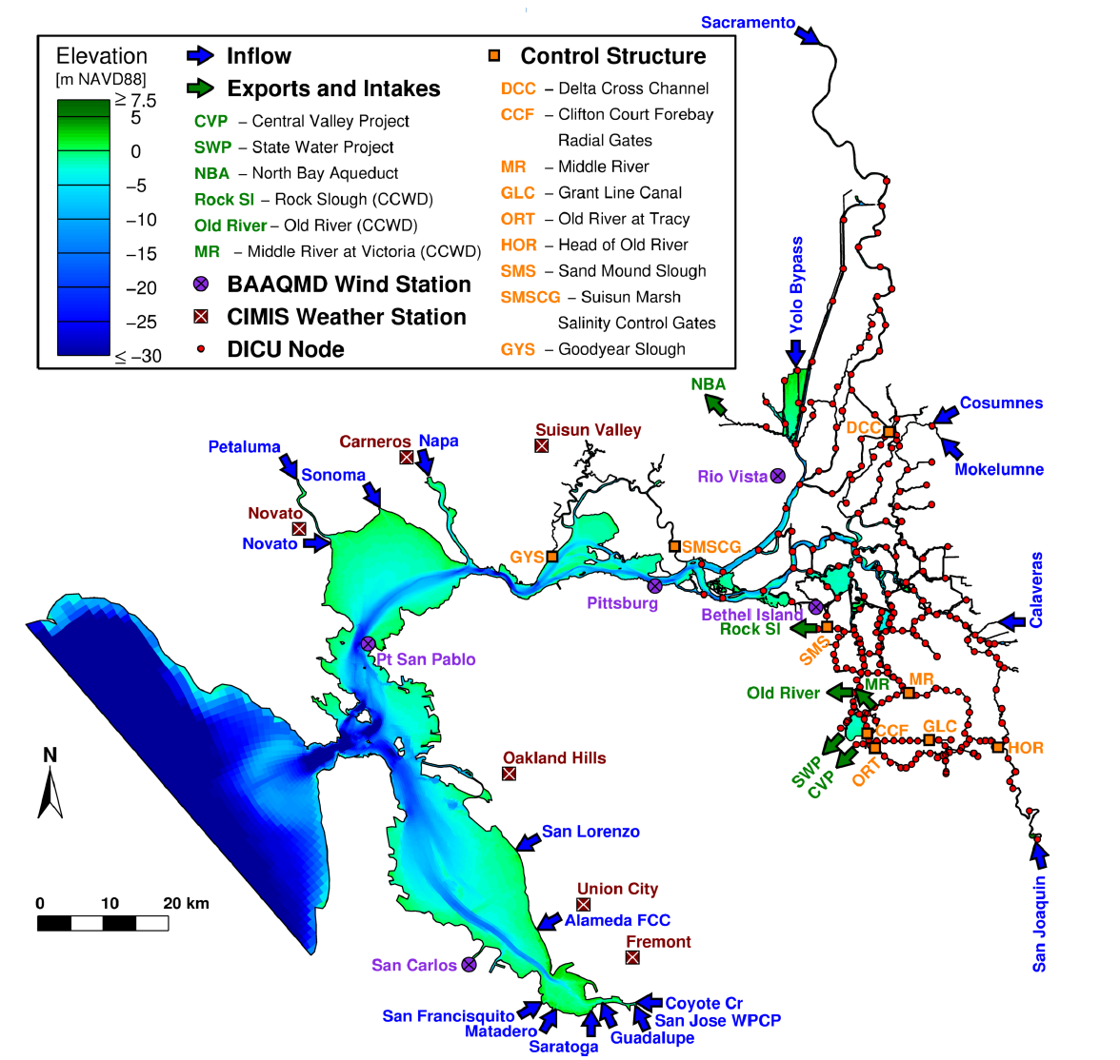
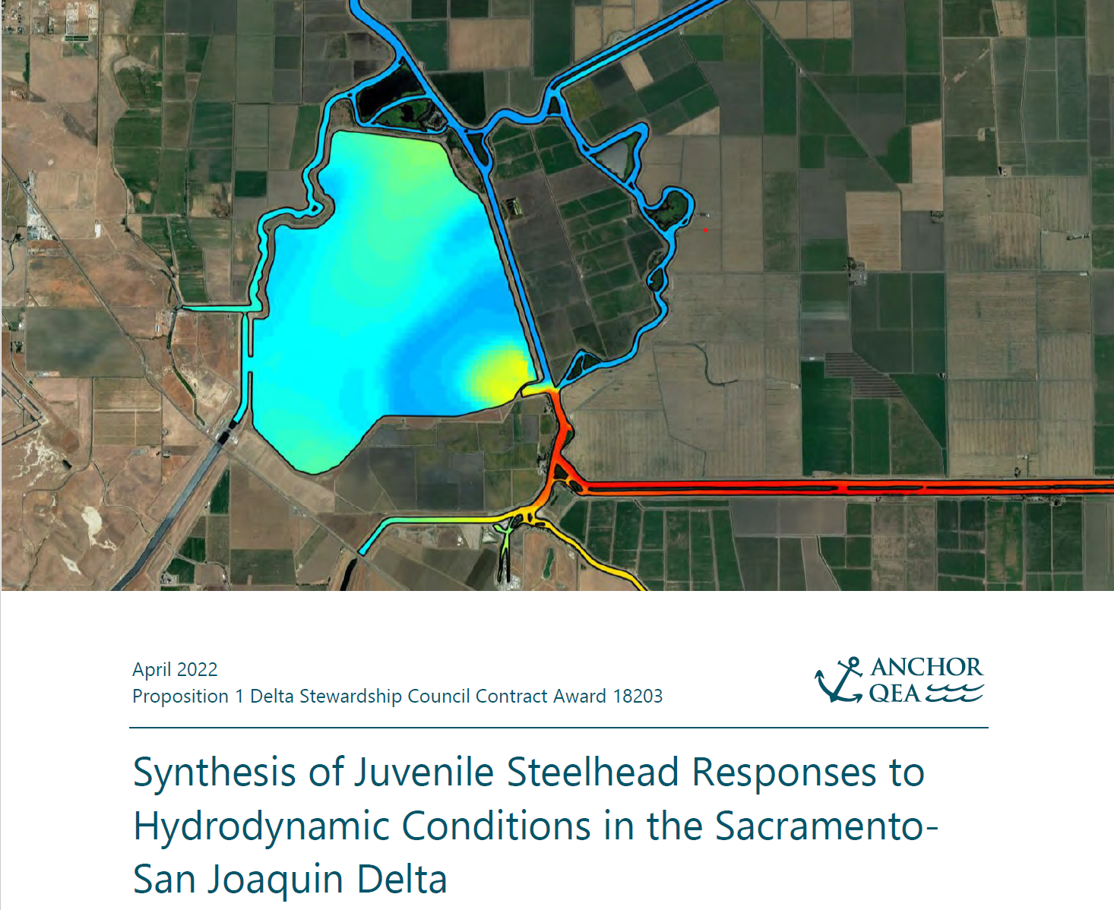

Covariates – Local Flow Conditions
Simulated local flow using the UnTRIM Bay-Delta Model
3-D hydrodynamic model of San Francisco Estuary and Delta
Simulated for Anchor QEA’s Prop 1 Award project
90-second time step measured at receiver locations
MacWilliams et al. 2015 – Figure 2: Model domain, bathymetry, locations of model input variables
MacWilliams et al. 2015
Anchor QEA 2022

Slide 16
Covariates – Local Flow Conditions
Net flow
Tidally averaged flow at SJO or SJS
Tidal flow
Total flow minus net flow
90-sec time step
Measured at SJO or SJS
Flow Proportion
Proportion of flow exiting junction that moves down mainstem (San Joaquin River)
90-sec time step
Measured at SJL vs ORE and MAC vs TRN
Notes:
Measured at receiver located just upstream of the river junction: SJO for head of Old River, and SJS for Turner Cut
Net flow, tidal flow = measured at time of arrival at junction
Flow proportion = measured at time of exit of junction

Slide 17
Covariates – Management-Relevant Metrics
Export rate
Daily mean at CVP, SWP
Delta inflow
Daily mean at Vernalis (VNS)
Ratio of Inflow : Exports
Daily mean inflow : Daily mean (combined) exports
Omitted from model because highly correlated with Delta inflow
r=0.82 for Head of Old River
r=0.79 for Turner Cut
VNS
Notes:
Export rate = measured at time of exit of junction
Delta inflow, IE = measured at time of arrival at junction

Slide 18
Covariates – “Individual” measures
Fork length at tagging
Time of Day
Day, night, or crepuscular
Head of Old River Barrier
TRUE/FALSE
TRUE = between day of closure and day of breach
VNS
Notes:
Time of Day = measured at time of arrival at junction
HOR barrier = measured at time of exit of junction

Slide 19
Modeling Results
Middle River Mouth; photo credit = Ken James, CDWR

Slide 20
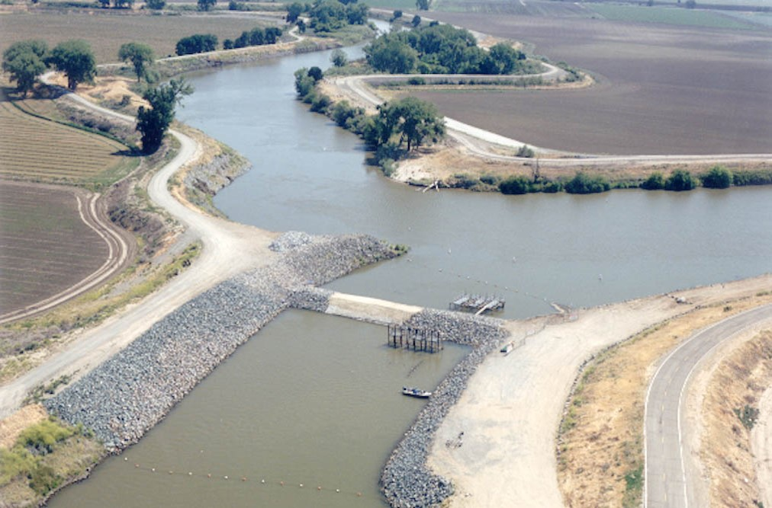
Head of old River Results
Head of Old River with rock barrier (2001; DWR)

Slide 21
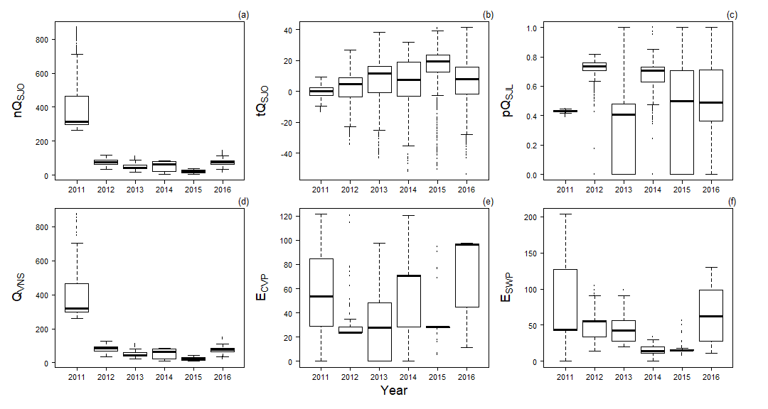
Head of Old River – Observed Covariates
Net flow
Tidal flow
SJR Flow Proportion
Correlation between Net flow and Delta inflow = 1.0
Delta inflow was used in place of Net flow in modeling at HOR
No other evidence of multicollinearity
Variance inflation factor ≤ 2.2 without Net flow
Local flow conditions
Management metrics
Delta inflow
CVP exports
SWP exports
Notes:
Pairwise correlation <= 0.61 for all pairs except Net flow and Delta inflow (r=1.0)

Slide 22
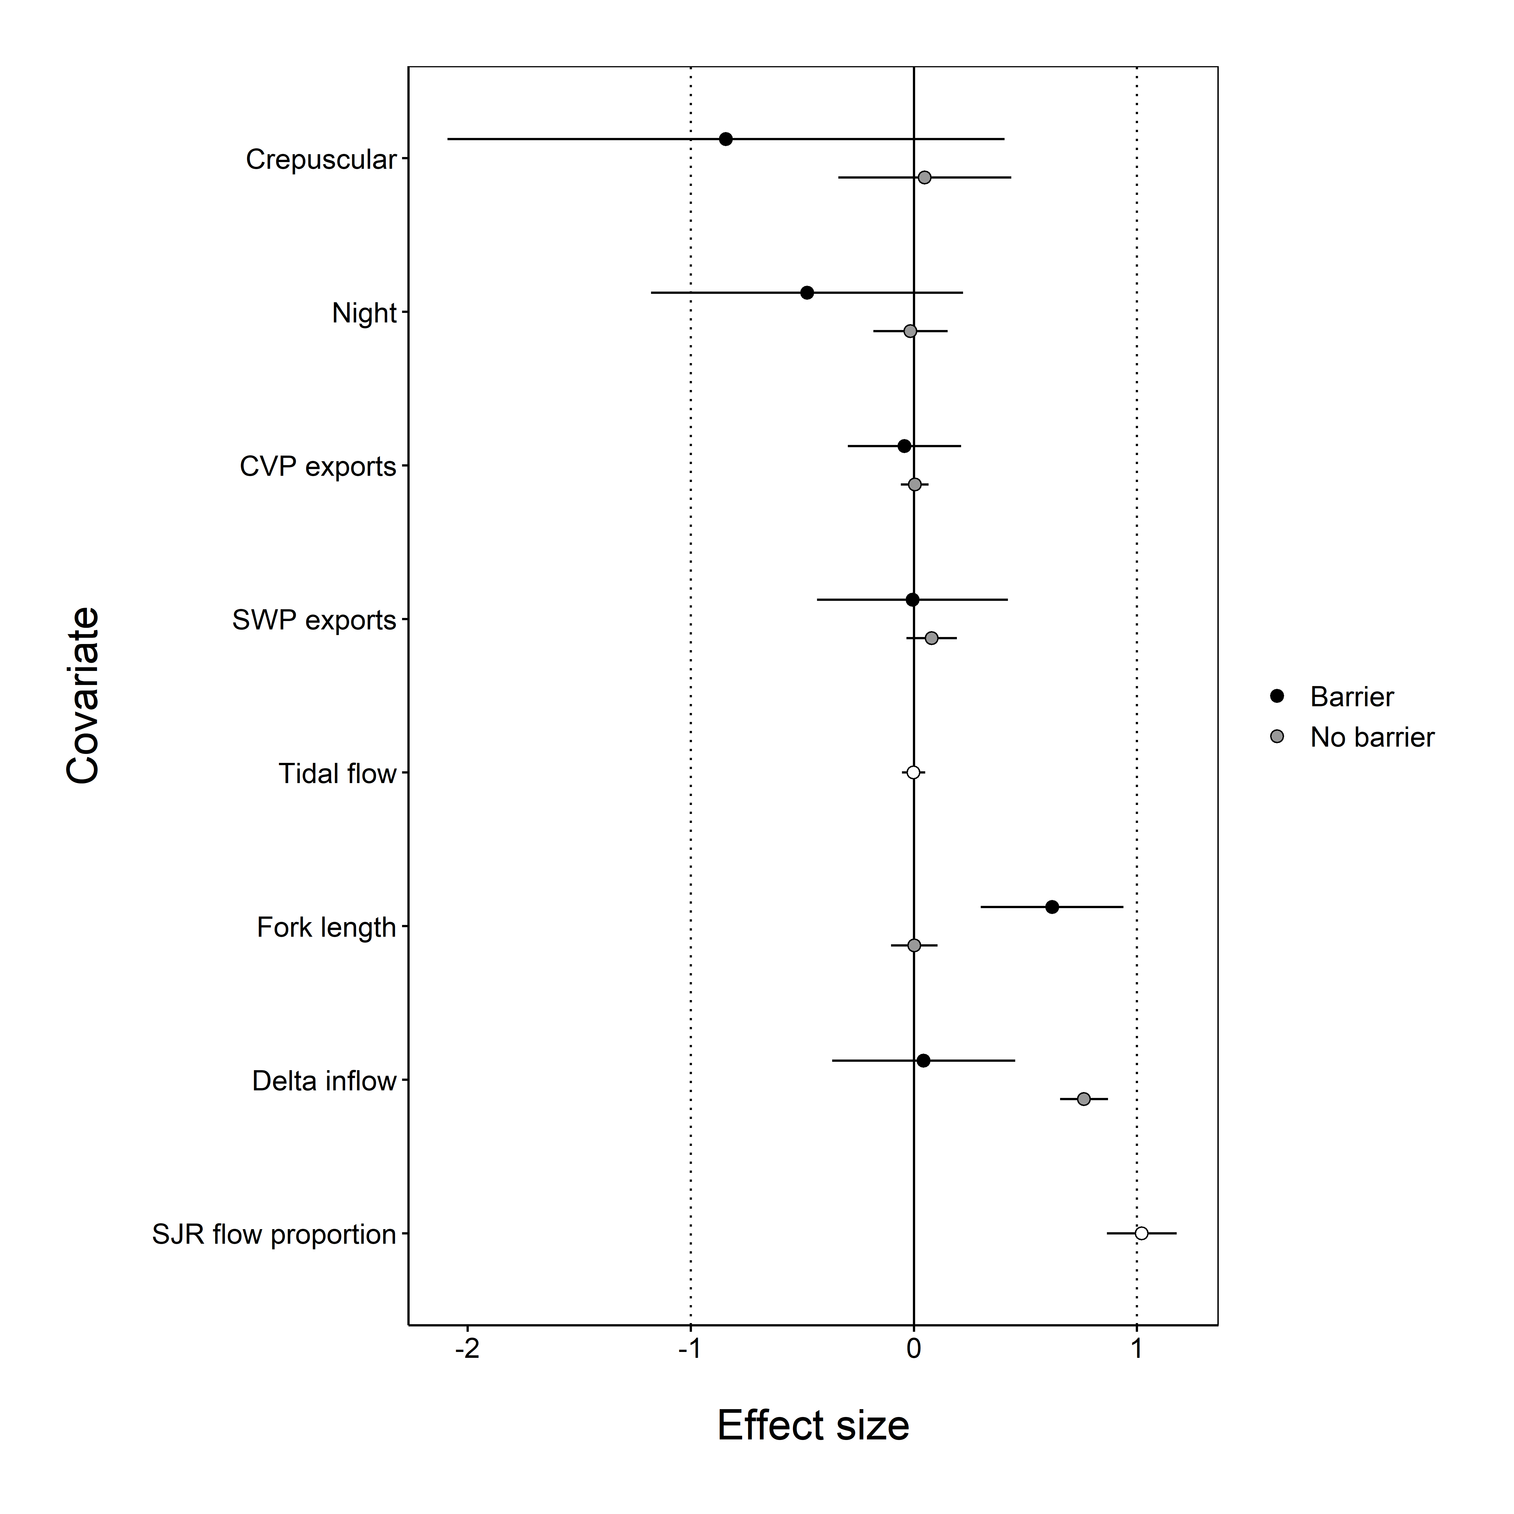
Head of Old River – Covariate Weights and Effect Size
Covariate | Type | Total weight
Barrier at HOR | NA | Included in all models
Net flow at entry | Local | -- See Delta inflow --
Tidal flow | Local | 0.241
Flow proportion | Local | 1.000
Delta inflow (log scale) | Management | 1.000
Exports at CVP | Management | 0.177
Exports at SWP | Management | 0.802
Fork length | Individual | 1.000
Time of day | Individual | 0.782
Positive effect → more likely to stay in SJR
Notes:
This table shows the total weight of all the models that included the covariate. Weights can range from 0 to 1, and higher weights imply more support for a relationship between the covariate and routing, compared to the other variables considered.
A complementary type of result is a plot of the estimated effect size, which is shown on the right. For each covariate, we see a point estimate of the effect size and the 95% confidence interval. If the point estimate and confidence interval are to the right of the vertical line at 0, then we conclude that higher values of the covariate are associated with higher use of the San Joaquin River route. If the point estimate and confidence interval are to the left of 0, then higher values of the covariate are associated with higher use of the Old River route. In this case, we have effects both with and without the barrier for some of the measures.

Slide 23
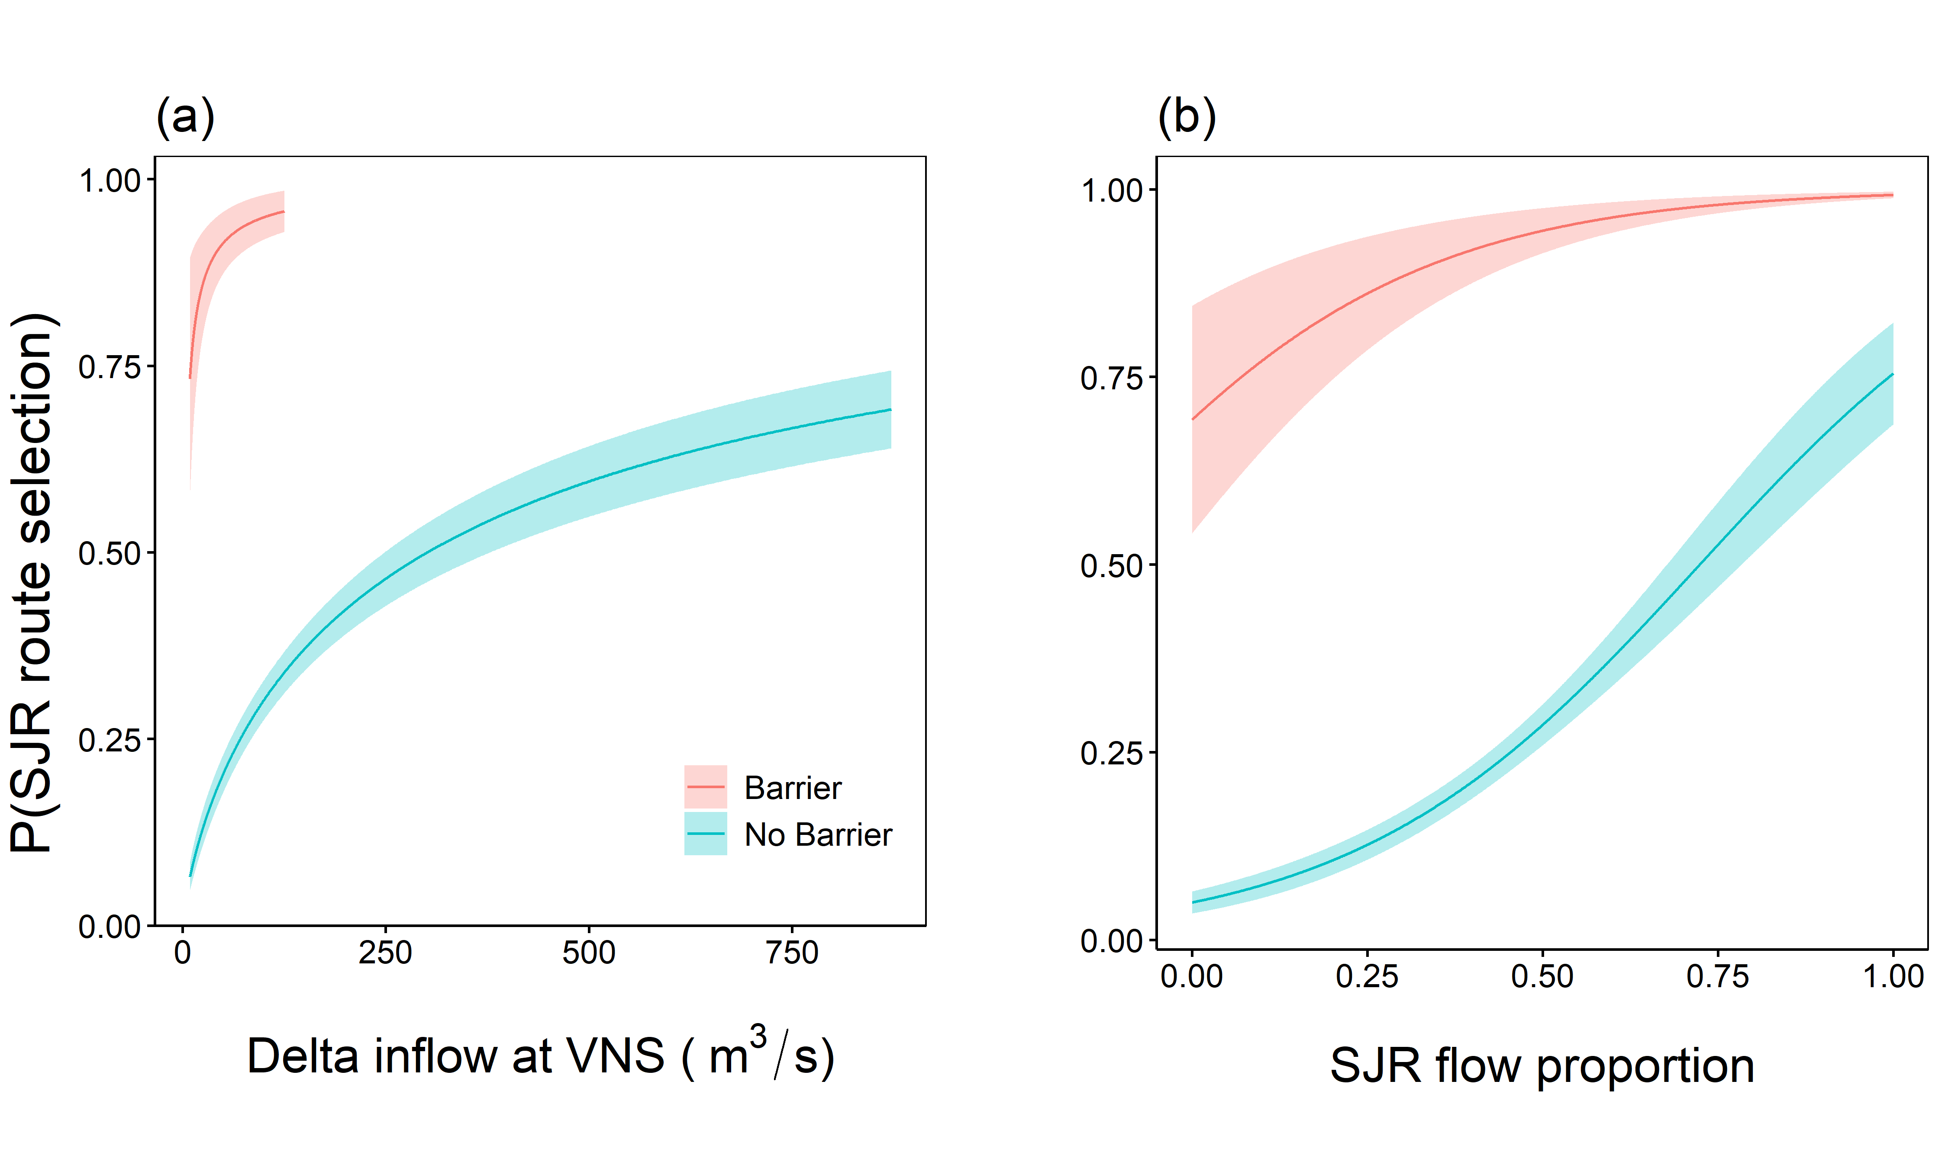
Head of Old River – Predicted probability of Using SJR route
Predictions were computed for daytime at study-wide means of other covariates:
Fork length = 245 mm
Tidal flow = 4.6 m³/s
SJR flow proportion = 0.48
Delta inflow = 81.5 m³/s
CVP exports = 48 m³/s
SWP exports = 53 m³/s

Slide 24
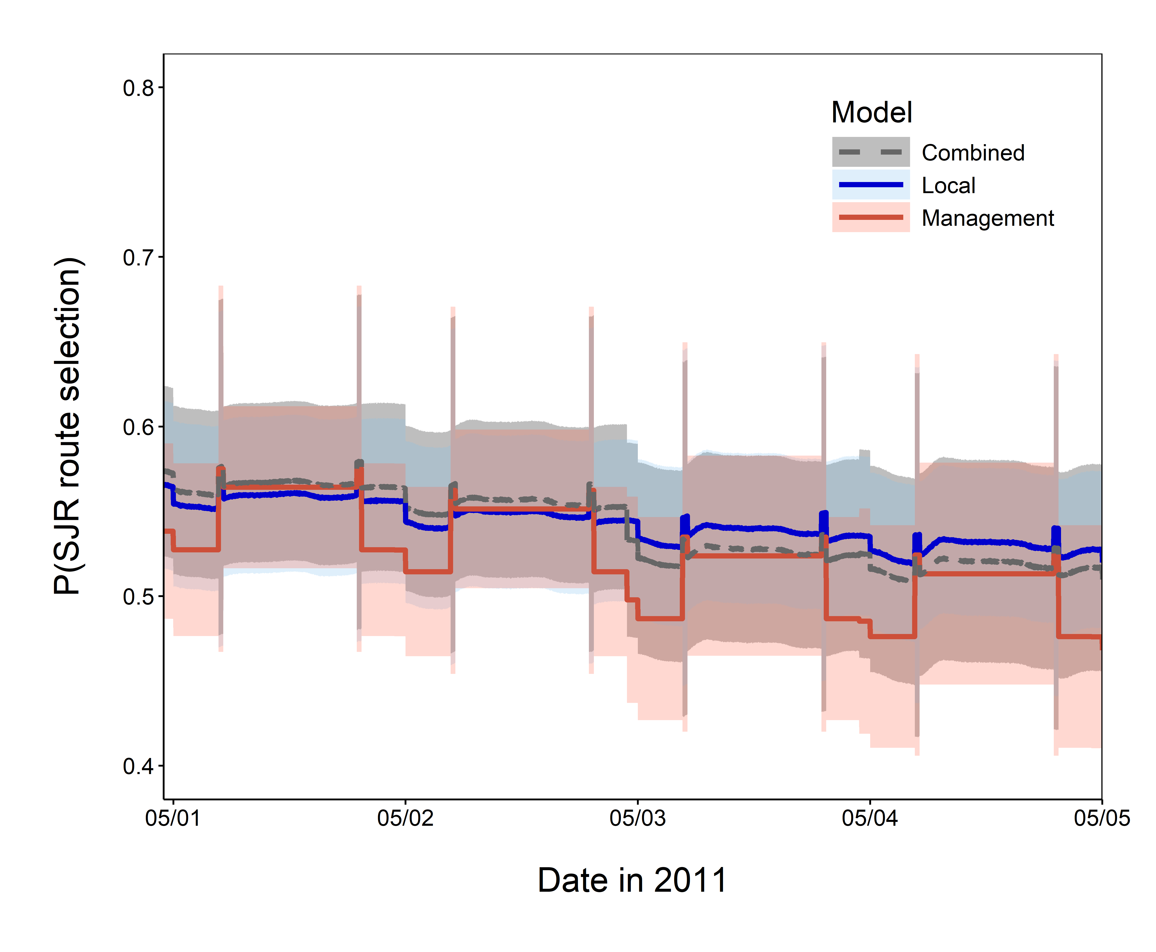
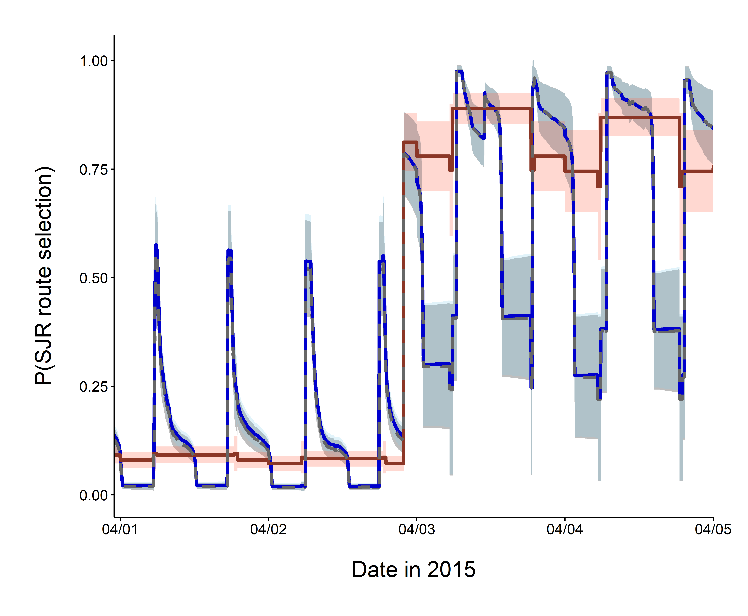
Head of Old River – Hindcast
Different vertical ranges
May 2011 – Wet year
April 2015 – Critically Dry Year
Closure of HOR Barrier
Notes:
Model fit: AUC = 0.903 for Management model, 0.913 for Local model, and 0.913 for Combined model (0.816 for Null model, 0.877 for Base model) – all data from all years

Slide 25
Head of Old River – Hindcast
Wet year (2011)
Management model underestimates mainstem usage at night (compared to Combined Model)
Local model has larger differences during day
Differences are within margin of error
Critically dry year (2015)
Management model misses subdaily fluctuations in route usage (tides)
Local model is very similar to Combined model
Closure of barrier had large effect on route use
Model predictive ability:
AUC = 0.903 for Management model (excellent predictive ability)
AUC = 0.913 for Local model (excellent predictive ability)
AUC = 0.913 for Combined model (excellent predictive ability)
Notes:
Model fit: AUC = 0.903 for Management model, 0.913 for Local model, and 0.913 for Combined model (0.816 for Null model, 0.877 for Fish model)

Slide 26

Hypothesis 1: Fish follow flow
Head of Old River
What we expected to find
What we found
Steelhead smolts’ routing is determined mostly by localized flow conditions
Smolts are more likely to select mainstem route when:
Flow proportion is higher in mainstem
Net flow entering junction from upstream is higher
On ebb tide
Net flow ≈ Delta inflow at HOR

Slide 27
Hypothesis 1: Fish follow flow
Head of Old River
What we expected to find
Steelhead smolts’ routing is determined mostly by localized flow conditions
Smolts are more likely to select mainstem route when:
Flow proportion is higher in mainstem
Net flow entering junction from upstream is higher
On ebb tide
X
Positive effect → more likely to stay in SJR
Notes:
Not a lot of variability in tidal flow at HOR

Slide 28
Hypothesis 2: Management metrics predict routing
Head of Old River
What we expected to find
What we found
Metrics used in water operations management can be used to predict routing at HOR
Fish are more likely to enter the interior Delta when
Daily export rates are higher
Delta inflow is lower
I:E ratio is lower

Slide 29
Hypothesis 2: Management metrics predict routing
Head of Old River
What we expected to find
What we found
Metrics used in water operations management can be used to predict routing at HOR
Fish are more likely to enter the interior Delta when
Daily export rates are higher
Delta inflow is lower
I:E ratio is lower
X
(yes… I:E is positively correlated with Delta inflow)
AUC = 0.903
Positive effect → more likely to stay in SJR
Notes:
Yes, management metrics can be used to predict routing at HOR – but still not as good as local covariates (flow proportion), especially in low flow years

Slide 30
Hypothesis 3: Individual conditions matter
Head of Old River
What we expected to find
What we found
Fish size
Larger fish are more likely to remain in mainstem
Time of day
No effect direction predicted
X
X
Positive effect → more likely to stay in SJR
Notes:
Fish size – yes with the barrier, no without the barrier.
Note that fish were larger on average in 2011 compared to the other years, and there was no barrier in 2011.

Slide 31
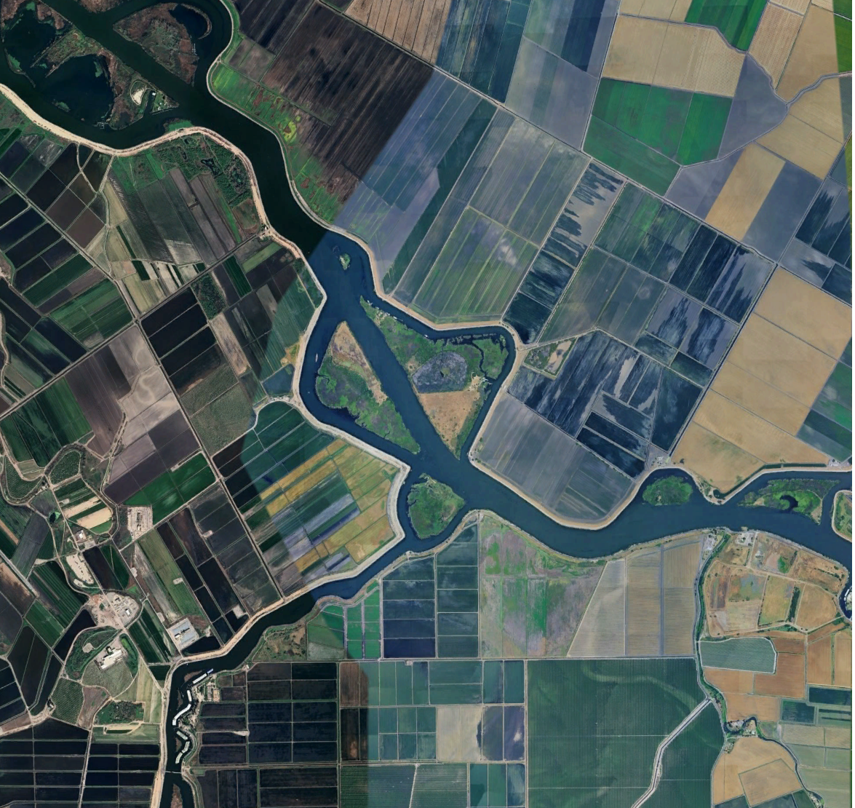
Turner Cut Results
Turner Cut – Google Earth v7.3.6.10201 (March 8, 2025) lat 37.992523˚, lon -121.442716˚, Eye alt 41031 ft, accessed June 18, 2025

Slide 32
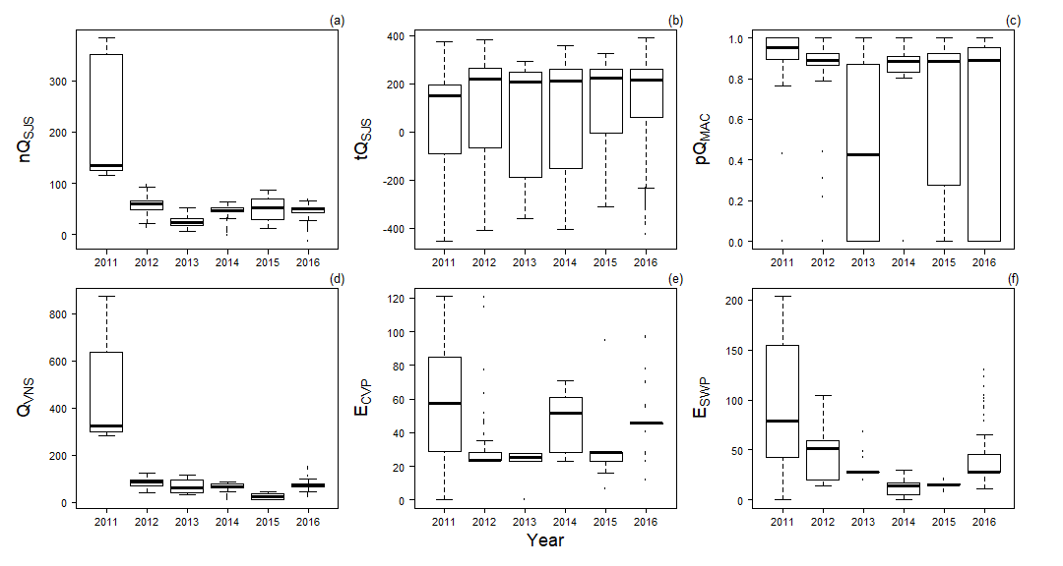
Turner Cut Junction– Observed Covariates
Net flow
Tidal flow
SJR Flow Proportion
Correlation between Net flow and Delta inflow = 0.86
No strong evidence of multicollinearity
Variance inflation factor ≤ 5.3
Retained both Net flow and Delta inflow
Net flow: localized measure
Delta inflow: remote management metric
Local flow conditions
Management metrics
Delta inflow
CVP exports
SWP exports
Notes:
Pairwise correlation <= 0.60 for all pairs except Net flow and Delta inflow (r=0.86)

Slide 33
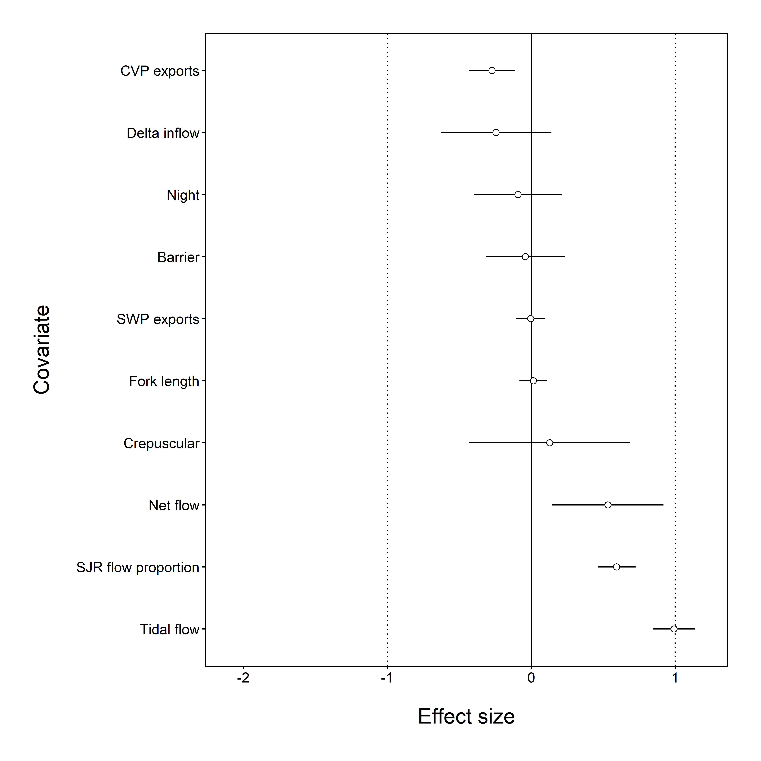
Turner Cut – Covariate Weights and Effect Size
Covariate | Type | Total weight
Barrier at HOR | Individual | 0.284
Net flow at entry | Local | 1.000
Tidal flow | Local | 1.000
Flow proportion | Local | 1.000
Delta inflow (log scale) | Management | 0.786
Exports at CVP | Management | 1.000
Exports at SWP | Management | 0.255
Fork length | Individual | 0.293
Time of day | Individual | 0.377
Positive effect → more likely to stay in SJR

Slide 34
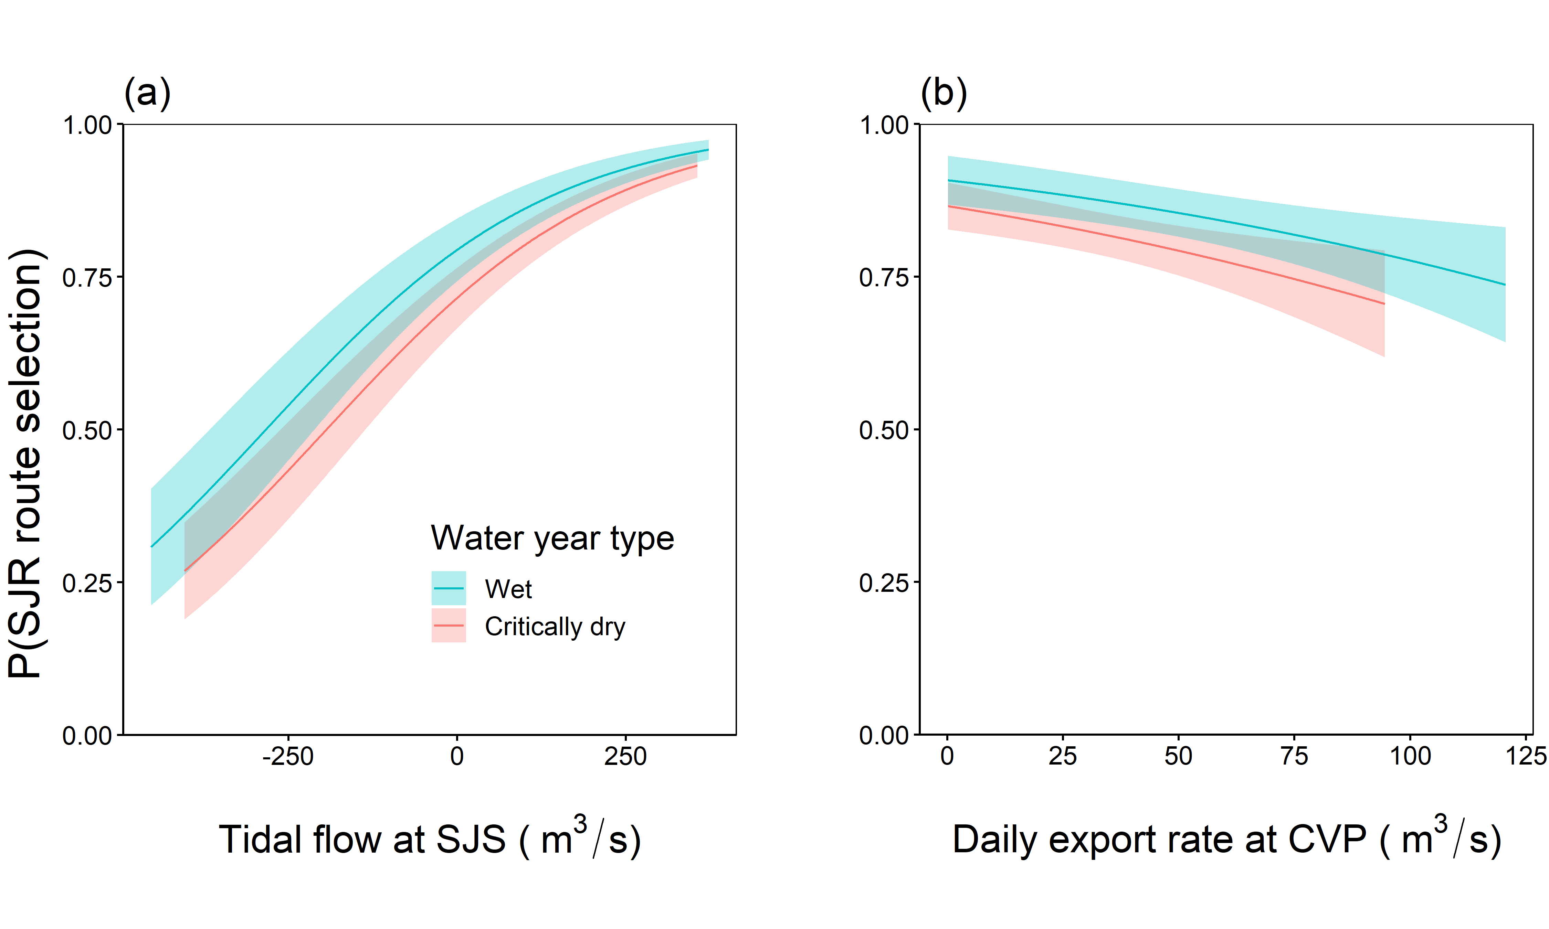
Turner Cut – Predicted probability of Using SJR route
Predictions were computed for
Wet year:
Delta inflow = 703 m³/s
Net flow = 205 m³/s
Critically dry year:
Delta inflow = 49 m³/s
Net flow = 46 m³/s
HOR barrier
During daytime at study-wide means of other covariates:
Fork length = 251 mm
Tidal flow = 99 m³/s
SJR flow proportion = 0.7
CVP exports = 45 m³/s
SWP exports = 50 m³/s
4,414 cfs

Slide 35
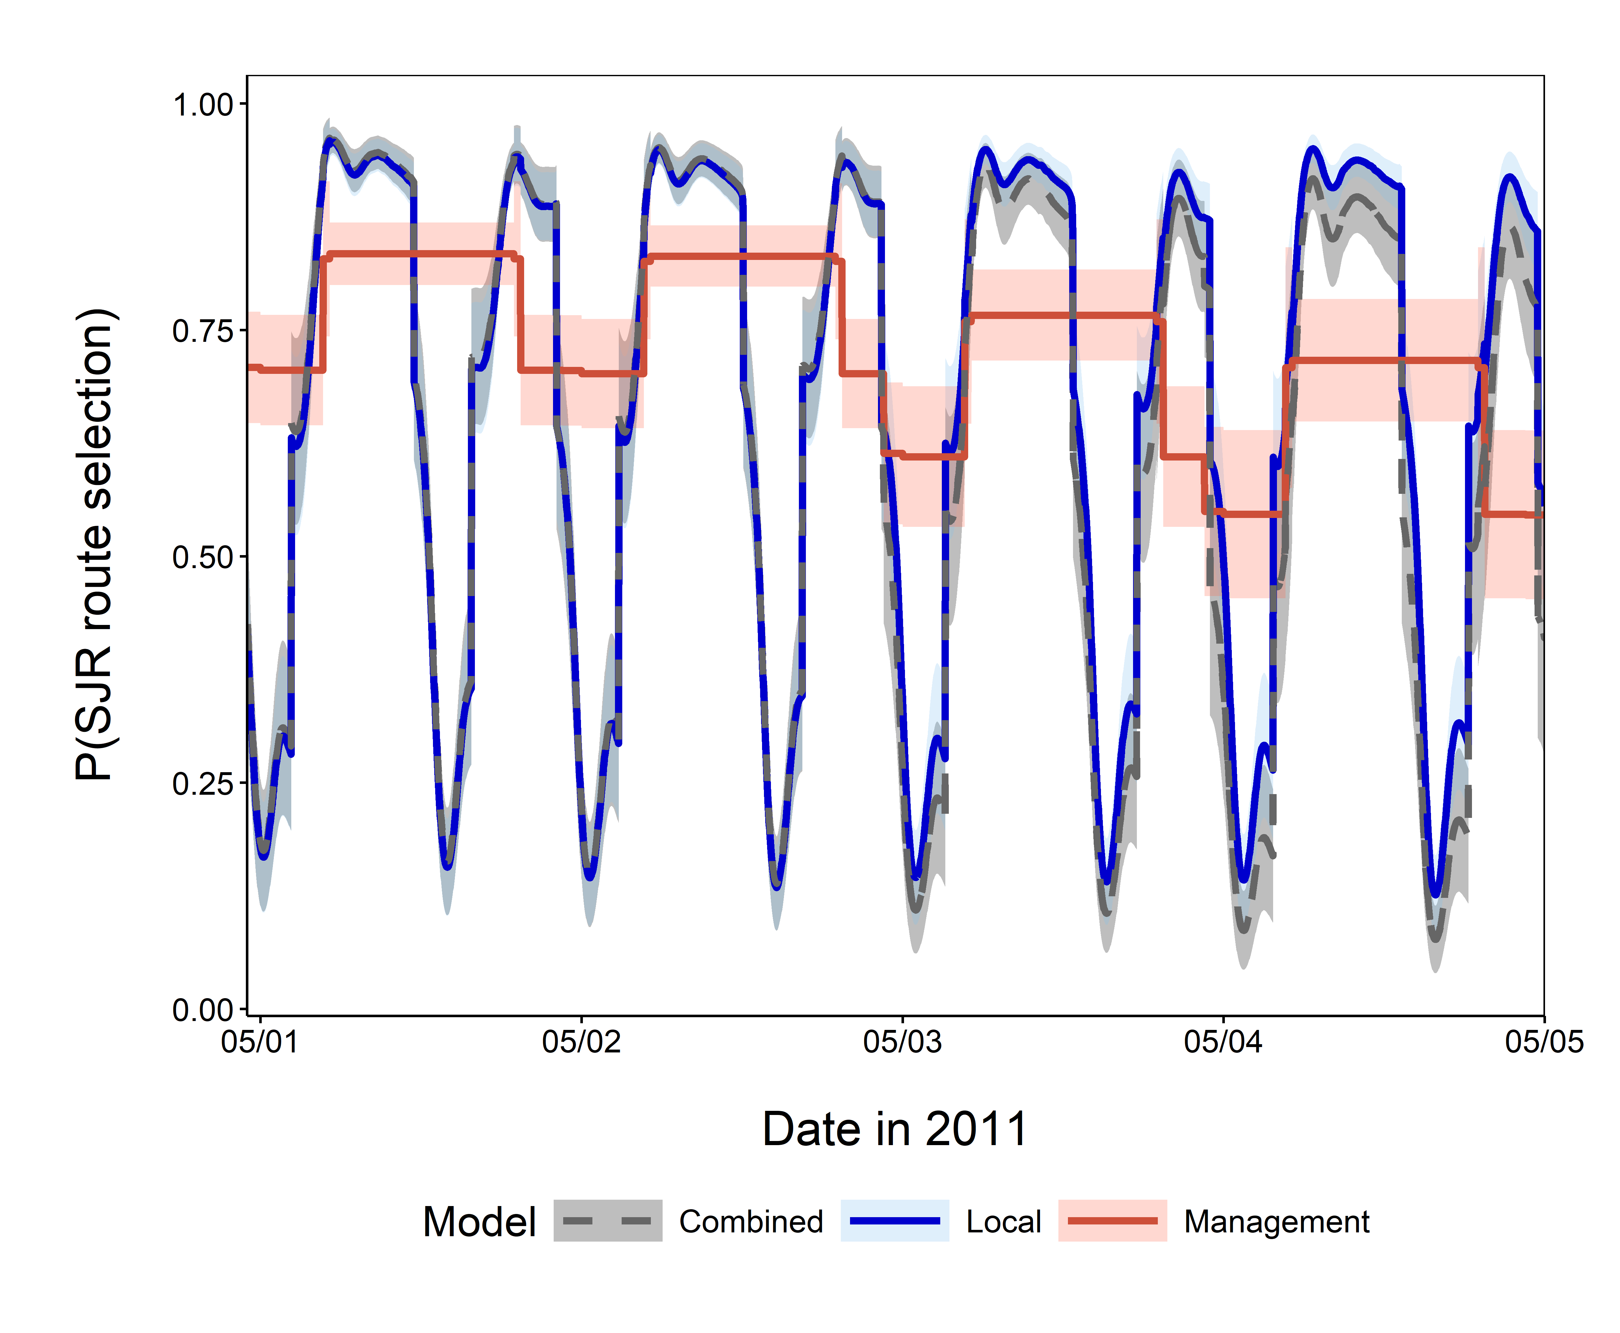
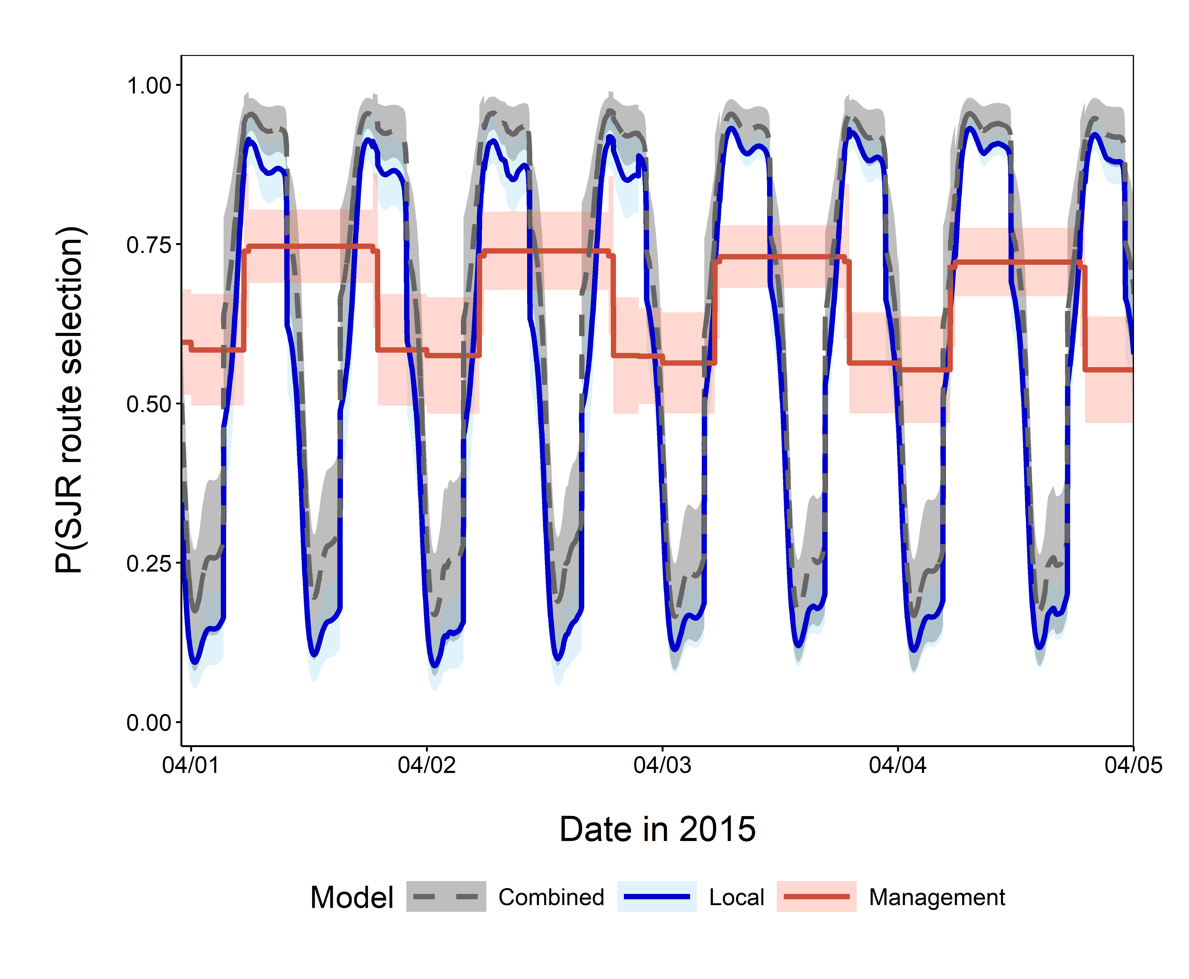
Turner Cut – Hindcast
May 2011 – Wet year
April 2015 – Critically Dry Year
Notes:
Model fit: AUC = 0.624 for Management model, 0.863 for Local model, and 0.864 for Combined model

Slide 36
Turner Cut – Hindcast
Management model missed subdaily fluctuations in route usage (tides) compared to Combined model
Local model is more like Combined model
Wet year: can overestimate mainstem usage
Critically dry year: underestimates mainstem usage
Differences are smaller than for Management model
Model predictive ability:
AUC = 0.624 for Management model (poor predictive ability)
AUC = 0.863 for Local model (excellent predictive ability)
AUC = 0.864 for Combined model (excellent predictive ability)

Slide 37
Hypothesis 1: Fish follow flow
Turner Cut
What we expected to find
What we found
Steelhead smolts’ routing is determined mostly by localized flow conditions
Smolts are more likely to select mainstem route when:
Flow proportion is higher in mainstem
Net flow entering junction from upstream is higher
On ebb tide
Positive effect → more likely to stay in SJR

Slide 38
Hypothesis 2: Management metrics predict routing
Turner Cut
What we expected to find
What we found
Metrics used in water operations management can be used to predict routing at TCJ
Fish are more likely to enter the interior Delta when
Daily export rates are higher
Delta inflow is lower
I:E ratio is lower
X
X
X
(no … I:E is positively correlated with Delta inflow)
AUC = 0.624
Positive effect → more likely to stay in SJR
Notes:
Fish being more likely to enter the interior Delta when export rates are higher – this is equivalent to fish being LESS likely to stay in the SJR route when exports are higher – so this is a negative effect of exports, which is what we see for CVP but not for SWP
For Delta inflow, we expect to see more fish in the interior Delta when inflow is lower, which is equivalent to more fish in the SJR route when Delta inflow is HIGHER – this would be a positive effect of Delta inflow, which is NOT what we see

Slide 39
Hypothesis 3: Individual conditions matter
Turner Cut
What we expected to find
What we found
Fish size
Larger fish are more likely to remain in mainstem
Time of day
No effect direction predicted
X
X
Positive effect → more likely to stay in SJR

Slide 40
Summary and Recommendations

Slide 41
Summary of Findings
Local flow conditions have a strong influence on route usage at both Head of Old River and Turner Cut
Management metrics have a weaker effect
Delta inflow, exports, IE
Can be used to predict routing at Head of Old River
Poor predictive ability at Turner Cut
Tidal flow has larger effect at Turner Cut
Smaller effect of fish size and time of day

Slide 42
Recommendations
Head of Old River
Consider installing barrier in dry years
Turner Cut
To keep steelhead smolts in the mainstem San Joaquin River
Continue to limit exports when smolts are expected in lower San Joaquin River
Restore habitat to encourage smolts to use eastern/northern sides of SJR as they approach Turner Cut
Improve survival of smolts in interior Delta – exports restrictions, habitat restoration

Slide 43
Acknowledgements
Funding: U.S. Bureau of Reclamation
Design and implementation of 6-year steelhead telemetry study
U.S. Bureau of Reclamation – Josh Israel
U.S. Fish and Wildlife Service – Pat Brandes, Bryan Matthias
U.S. Geological Survey – Jon Burau, Chris Vallee, Mike Simpson, Scott Brewer
California Department of Water Resources – Kevin Clark
UnTRIM Bay-Delta Model simulated flow data
Aaron Bever, Sydney Gonsalves (Anchor QEA)
Analysis discussion
Josh Israel (USBR)
Russell Perry (USGS)
John Ferguson (Anchor QEA)
Route manuscript review
Elissa Buttermore, Lisa Harn Elliott (USBR)
Graphics and editing
Steve Whitlock, Craig Scanlan (UW)
Middle River Mouth; photo credit = Ken James, CDWR
Notes:
2011 – 2016 6-year study: Cooperative Agreement R17AC00042

Slide 44
Questions?
Route Modeling Results

